Slide 1






Enhanced environmental protection inspection for efficient control of air quality monitoring and of all entities under obligation within system of greenhouse gas emission allowance trading, in order to achieve better quality of air in Republic of Croatia
This project is funded by the European Union

Slide 2



8. AIR QUALITY MONITORING STATIONS
Energy research and Environmental Protection Institute
Bojan Abramović, dipl.ing.stroj.

Slide 3

8.1. STATIONS WITH SAMPLING METHODS
For some pollutants sampling (manual) methods are used with subsequent analysis in laboratories. The most known is gravimetric method (reference method) for determine the floating particles that begin by sampling. There is a sampling method for almost all pollutants. The problem is that these methods are not reference and can not be used without a study of equivalence. Also, they have no time resolution of less than 24 hours. The advantage is more reliable measurement at low concentrations.
Energy Research and Environmental Protection Institute
Energy Research and Environmental Protection Institute
Energy Research and Environmental Protection Institute

Slide 4
8.1. STATIONS WITH SAMPLING METHODS
Types of sampling
sampling of the air
passive sampling on solid sorbent
active sampling on solid sorbent
active fluid sampling (impinger)
sampling on the paper filter
Energy Research and Environmental Protection Institute
Energy Research and Environmental Protection Institute
Energy Research and Environmental Protection Institute

Slide 5
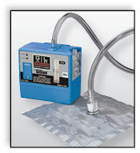
8.1. STATIONS WITH MANUAL METHODS
sampling of the air
Although it is not used in AQM we mention it because it is often used for sampling in cases of accident (fires, etc.) This is the simplest way of sampling where the pump is sampling the air into (most often) so-called. Tedler bags, or into the canisters. Saving the sample, in this case, should not be longer than 1-3 days, so it is best way to get it, as soon as possible, to the laboratory.
These samples are most often
analysed by methods of GC-MS.
Energy Research and Environmental Protection Institute
Energy Research and Environmental Protection Institute
Energy Research and Environmental Protection Institute

Slide 6
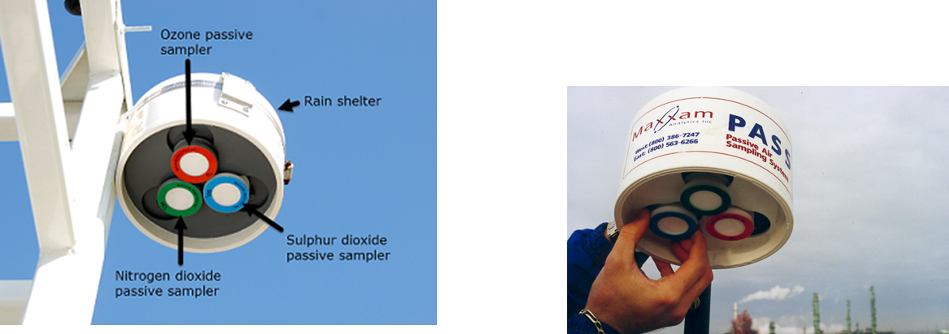
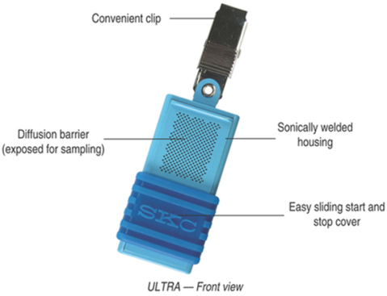
8.1. STATIONS WITH MANUAL METHODS
Passive sampling on solid sorbent
Air is sampled on a separate solid surface adapted to the pollutant which has to be sampled. Pollutant. The substance enters through passive diffusion and adsorbs on the surface. Later in the laboratory, a variety of methods have been using for desorption of the substance and determine its concentration in the sample. Some EU member countries (Austria), in this way, measure the concentration of benzene and very often this method is used for research of fugitive emissions with unpleasant smells on the border of the property. In Croatia we almost do not use this method in AQM, more often in the work environment.
Energy Research and Environmental Protection Institute
Energy Research and Environmental Protection Institute
Energy Research and Environmental Protection Institute

Slide 7
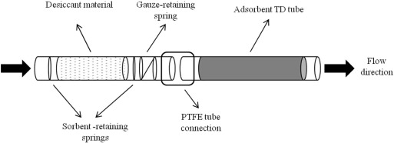
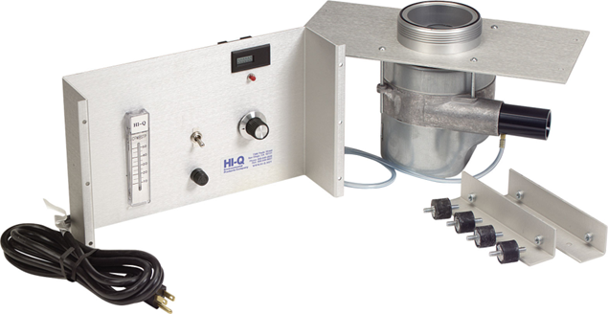
8.1. STATIONS WITH MANUAL METHODS
Active sampling on solid sorbent
With this method, air is actively pumped through tanks containing more or less specific adsorbent to one pollutant or a group of compounds (eg. VOC, merkaptans, etc.). The passage of air through the adsorbent causes a chemical reaction sampled chemical compound and adsorbent. Later, different methods will be used for desorption and determine of pollutant content. For this method of sampling it is necessary to have reliable pump and traceable flow meter (volume) of the sampled air.
Energy Research and Environmental Protection Institute
Energy Research and Environmental Protection Institute
Energy Research and Environmental Protection Institute

Slide 8
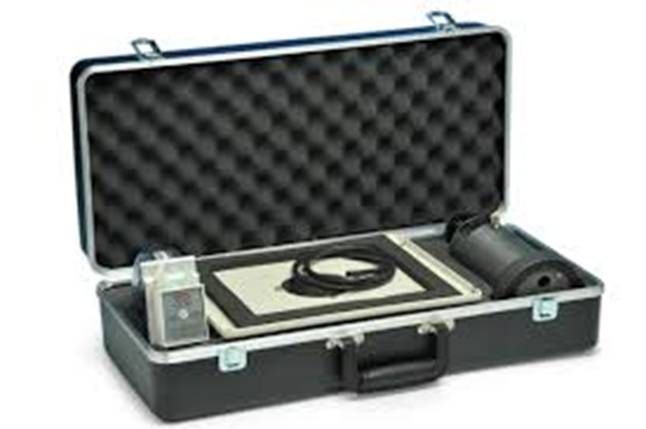
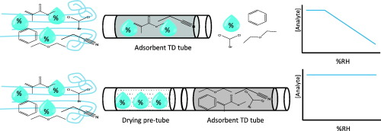
8.1. STATIONS WITH MANUAL METHODS
Active sampling on solid sorbent
For different pollutants, there are different methods developed with the specific adsorbens and a known percentage of adsorption (efficiency). The most popular method used this kind of sampling is the reference method for the measurement of benzene in the air the HRN EN 14662-1 – Measurement of concentrations of benzene – part 1: Sampling with suction and thermal desorption and analysis of gas chromatography
Energy Research and Environmental Protection Institute
Energy Research and Environmental Protection Institute
Energy Research and Environmental Protection Institute

Slide 9
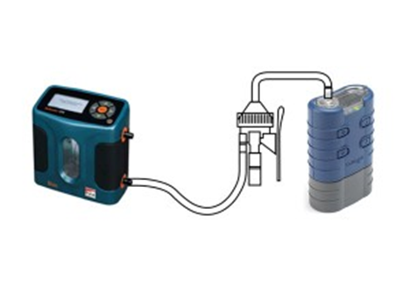
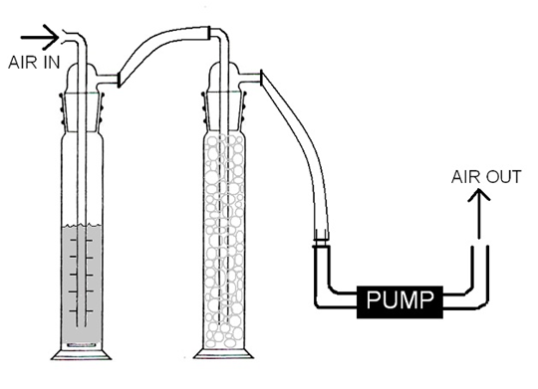
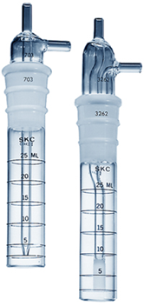
8.1. STATIONS WITH MANUAL METHODS
Active fluid sampling (impinger)
This method is very similar to the active sampling on solid sorbent. Air only passes through the liquid located in the specially designed cylinder (impinger). The method is less used because it is complicated and not a reference method.
Energy Research and Environmental Protection Institute
Energy Research and Environmental Protection Institute
Energy Research and Environmental Protection Institute

Slide 10
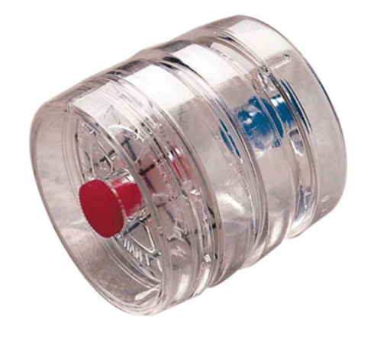
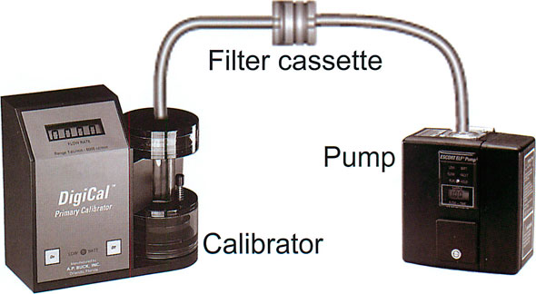
8.1. STATIONS WITH MANUAL METHODS
Active sampling on the paper filter - vapor
This method is very similar to the active sampling on solid sorbent. Air only passes through a filter located in the specially designed holder. One of these techniques is often used for the vaporous pollutant. The filter paper is impregnated with chemicals that causes a chemical reaction with the pollutant.
Energy Research and Environmental Protection Institute
Energy Research and Environmental Protection Institute
Energy Research and Environmental Protection Institute

Slide 11
8.1. STATIONS WITH MANUAL METHODS
Active sampling on the paper filter - particles
The reference method for the measurement of the particles PM10/2.5 HRN EN 12341 – Standard gravimetric measurement method for the determination of the mass concentration of PM10 and PM 2.5 fraction of airborne particles uses the sampling method of particles on the filter paper with the previously separation in specially designed "head" of sampler. This method separates only the particles of the default aerodynamic diameter and larger particles "stick" to the so-called impactor. So the filter separates particles of the same or smaller aerodynamic diameter than the default.
Energy Research and Environmental Protection Institute
Energy Research and Environmental Protection Institute
Energy Research and Environmental Protection Institute

Slide 12
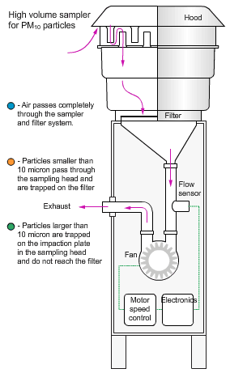
8.1. STATIONS WITH MANUAL METHODS
Sampling of PM₁₀
Energy Research and Environmental Protection Institute
Energy Research and Environmental Protection Institute
Energy Research and Environmental Protection Institute

Slide 13
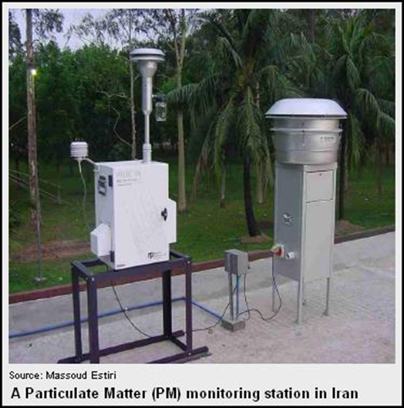
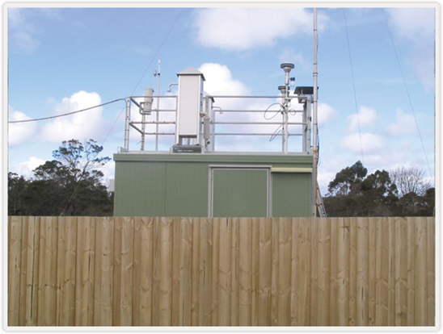
8.1. STATIONS WITH MANUAL METHODS
Active sampling on the paper filter - particles
The reference method for the measurement of the particles PM10/2.5 HRN EN 12341 – Standard gravimetric measurement method for the determination of the mass concentration of PM10 and PM 2.5 fraction of airborne particles. The filters are weighed before and after sampling. The mass concentration of particles is determined by the difference in mass and the known volume of sampled air.
Energy Research and Environmental Protection Institute
Energy Research and Environmental Protection Institute
Energy Research and Environmental Protection Institute

Slide 14
8.2 Automatic air quality monitoring stations
Types of monitoring stations
Container type fixed station
Compact fixed monitoring station
Mobile monitoring station on the vehicle
Mobile monitoring station on trailer
Energy Research and Environmental Protection Institute
Energy Research and Environmental Protection Institute
Energy Research and Environmental Protection Institute

Slide 15
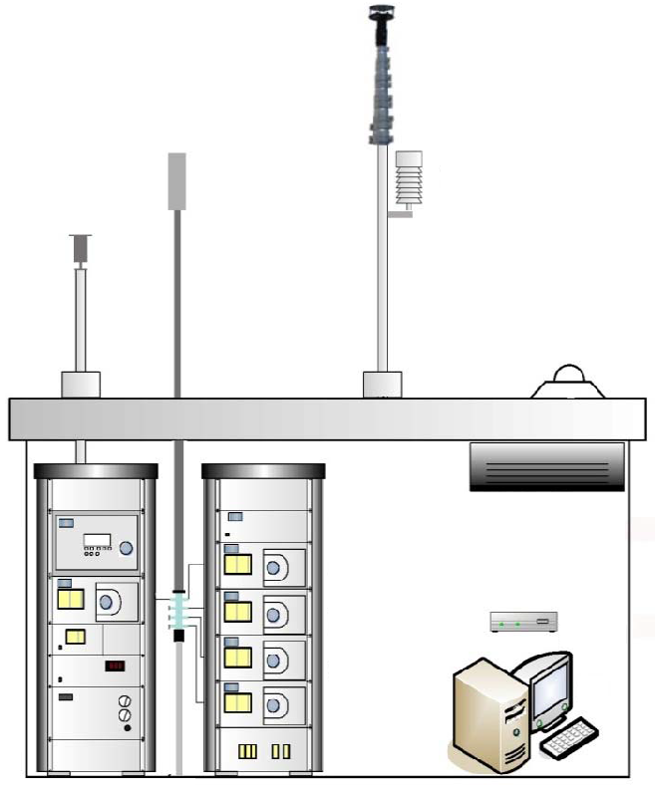
Infrastructure of the monitoring station
Infrastructure of the
monitoring station
Meteorological sensors
Systems for sampling gases and airborne particles
Furniture and other ...
Fire protection and anti-theft protection system
Electrical installation
The air-conditioned space inside the containers, trailers or vehicles
Housings for instruments (19” rack)
Measuring devices for gases and airborne particles
IT equipment for collection and processing of data, management of work devices and external communication
Equipment for quality control measurements
Energy Research and Environmental Protection Institute
Energy Research and Environmental Protection Institute
Energy Research and Environmental Protection Institute

Slide 16
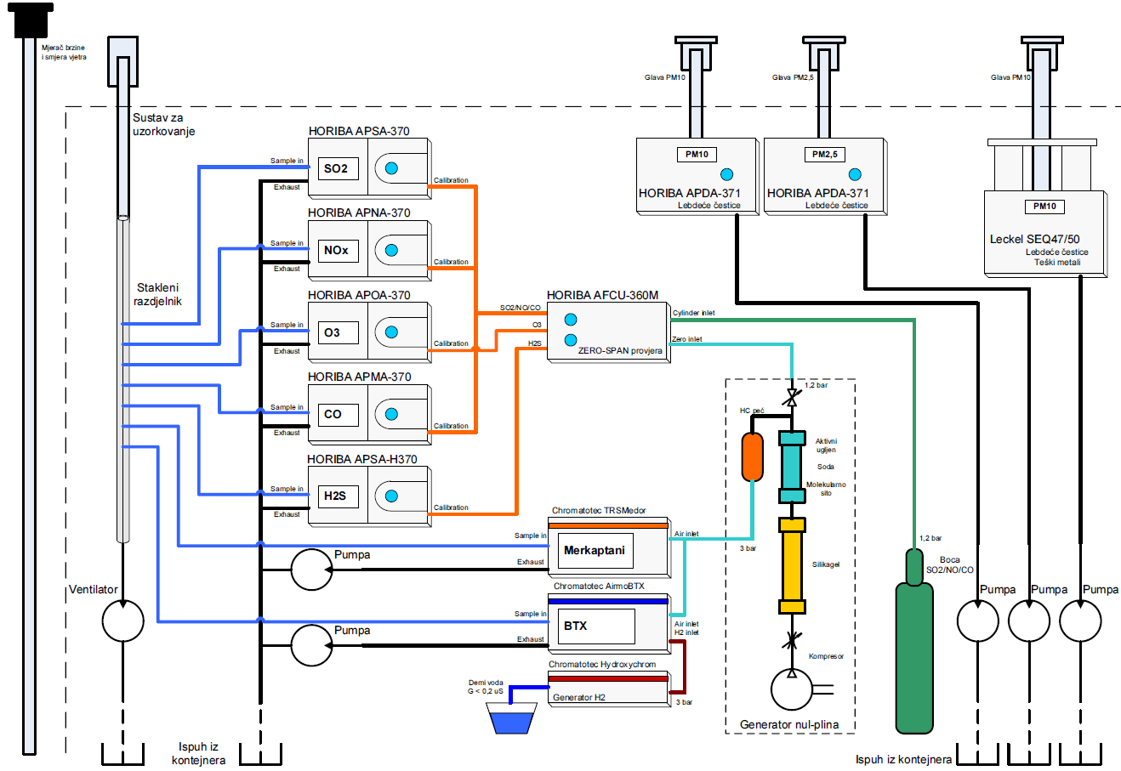

An example of connecting equipment in monitoring station (pneumatica)
Air sampling and measurement
Energy Research and Environmental Protection Institute
Energy Research and Environmental Protection Institute
Energy Research and Environmental Protection Institute

Slide 17

An example of connecting equipment in monitoring station (pneumatica)
Zero-span checking SO2
Energy Research and Environmental Protection Institute
Energy Research and Environmental Protection Institute
Energy Research and Environmental Protection Institute

Slide 18
An example of connecting equipment in monitoring station (pneumatica)
Zero-span checking NO
Energy Research and Environmental Protection Institute
Energy Research and Environmental Protection Institute
Energy Research and Environmental Protection Institute

Slide 19
An example of connecting equipment in monitoring station (pneumatica)
Zero-span checking O3
Energy Research and Environmental Protection Institute
Energy Research and Environmental Protection Institute
Energy Research and Environmental Protection Institute

Slide 20
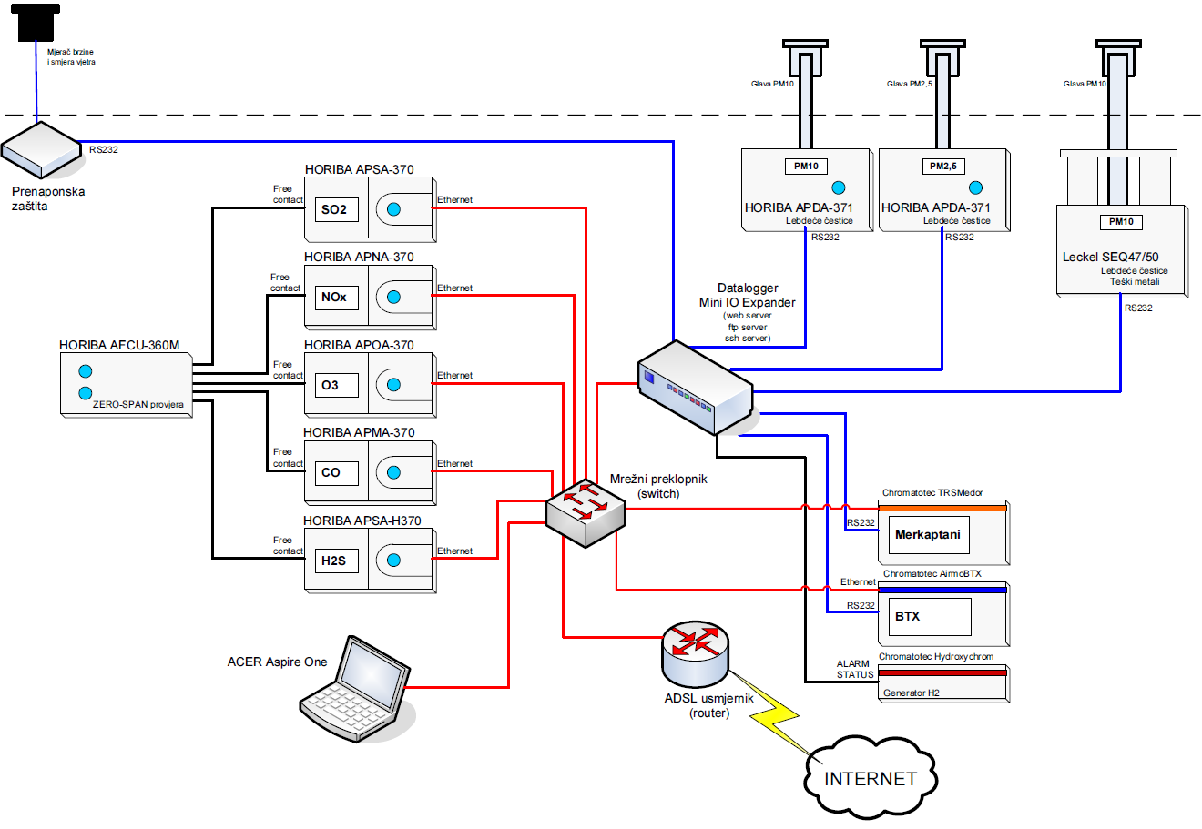
An example of connecting equipment in monitoring station (signal)
Air sampling and measurement
RS232 communication
Network communication
Send data after collection and processing
Energy Research and Environmental Protection Institute
Energy Research and Environmental Protection Institute
Energy Research and Environmental Protection Institute

Slide 21
An example of connecting equipment in monitoring station (signal)
Zero-span checking SO2
Energy Research and Environmental Protection Institute
Energy Research and Environmental Protection Institute
Energy Research and Environmental Protection Institute

Slide 22
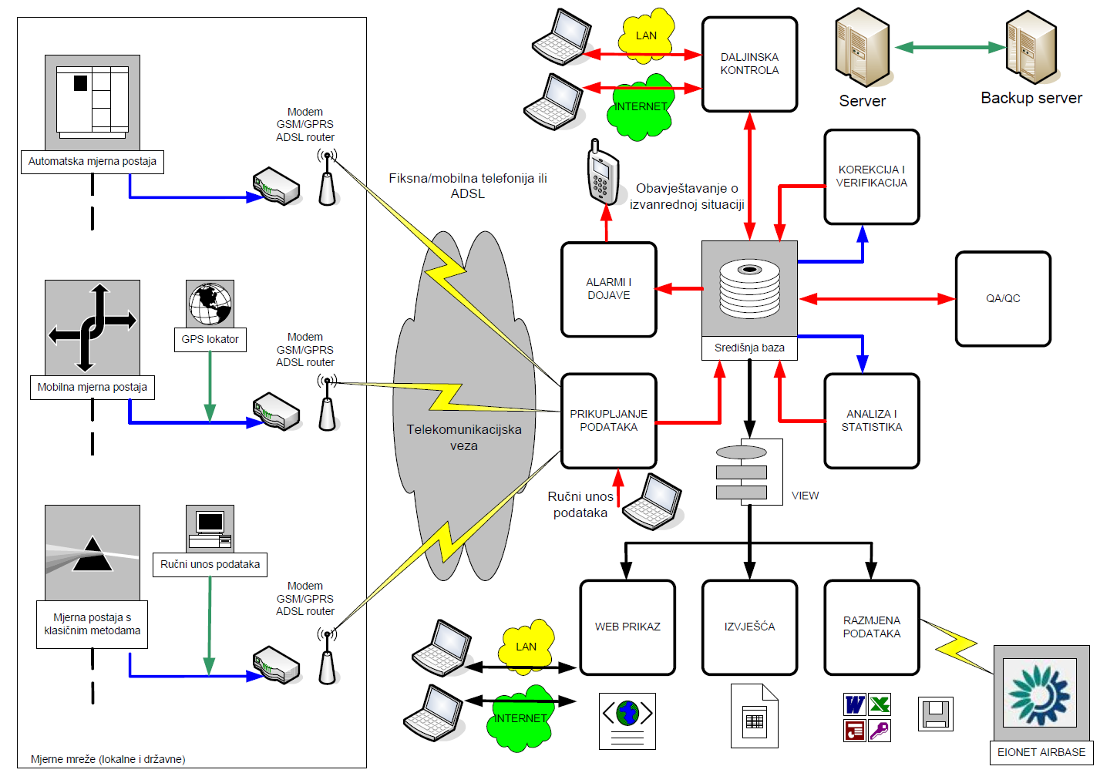



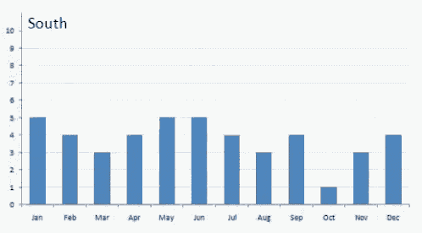
Network information system for air quality
Energy Research and Environmental Protection Institute
Energy Research and Environmental Protection Institute
Energy Research and Environmental Protection Institute

Slide 23
8.3 Maintenance of the monitoring stations
Regular maintenance
Two weeks regular visits
Infrastructure checking, exchange of filtars , minor corrections, devices parameter control
Intervention
Extraordinary arrivals to the location upon call
carry out activities outside the regular maintenance, for example failures, interruptions of operation, system blockage caused by power supply interruption
Annual service
works on infrastructure (air-conditioners, suctions, pipes ...)
the regular changes of spare parts and chemicals in the analysers
Calibration
usually after a larger intervention or annual service analysers are placed in the initial working range with calibration
Energy Research and Environmental Protection Institute
Energy Research and Environmental Protection Institute
Energy Research and Environmental Protection Institute

Slide 24
Example of regular maintenance procedures (SOP Ekonerg)
Regular maintenace 2x per month
Checking the status of the measuring devices and infrastructure
Equipment in good condition?
Writing reports about defects in the station log
Yes
No
Regular replacement of parts and record the condition of the equipment
Communication with the technical supervision and user support
Repair possible on site?
Routine corrective action if necessary
Yes
No
Request for intervention or disassembly of the device and the transport to the service
Device repair
Writing activity reports in the station log
Informing the owner of the measuring station and the institution responsible for the measurements
Energy Research and Environmental Protection Institute
Energy Research and Environmental Protection Institute
Energy Research and Environmental Protection Institute
Energy Research and Environmental Protection Institute

Slide 25
An example of technical supervision procedures (SOP Ekonerg)
Daily monitoring of the measuring stations
Connect with measuring stations, remote check the status of the measuring devices and IT infrastructure
Writing reports about defects in the archives of the station
Communication with the Service Center
Yes
No
The parameters are correct?
Malfunction requires immediate intervention?
No
Yes
The activation of the emergency order and the availability of the service
Activation of the service order
Service intervention durin the next regular maintenance
Service intervention within 48 hours
Writing activity reports in the station log
Informing the owner of the measuring station and the institution responsible for the measurements
Energy Research and Environmental Protection Institute
Energy Research and Environmental Protection Institute
Energy Research and Environmental Protection Institute

Slide 26
An example of the procedure of the service support (SOP Ekonerg)
Call from technical supervision or the operator at the stations
Activate an account
REGULAR SERVICE
INTERVENTION
Regular service or intervention?
Yes
Emergency service?
No
Service intervention within 48 hours
Go to the location in agreement with the technical supervision
Service site actions or transportation and service in the central service
Writing activity reports in the station log
Informing the technical supervision about activities
Energy Research and Environmental Protection Institute
Energy Research and Environmental Protection Institute
Energy Research and Environmental Protection Institute

Slide 27
Communication in the air quality monitoring system
In the maintenance of the monitoring stations communication of technical staff with the testing laboratory, with the owners of the stations and, if necessary, with other relevant institutions has crucial importance.
Regular communication about the activities
Requesting for corrective actions on the AQM system
Reporting on reaction and performing corrective actions on the AQM system
The owner of the measuring stations
The team for the regular maintenance
Technical surveillance for for air qualitymonitoring systems
The institution responsible for measurement
Team for the intervention and Service Center
Calibration laboratory
Energy Research and Environmental Protection Institute
Energy Research and Environmental Protection Institute

Slide 28
THANK YOU FOR YOUR ATTENTION
Energy Research and Environmental Protection Institute
Disclaimer: The contents of this publication are the sole responsibility of EKONERG – Energy Research and Environmental Protection Institute, Ltd. and can in no way be taken to reflect the views of the European Union
This project is funded by the European Union

